Slide 1



Case Study Title:-Predictive Maintenance in Solar Power System
JSPM BHIVRABAI SAWANNT POLYTECHNIC
Student Name:
1.Tanmay Vinayak Hargude.

Slide 2
Problem Statement
Case:-Predictive Maintenance in Solar Power Systems.
Solar power plants play a crucial role in the transition toward clean energy. However, maintaining large solar farms is challenging, as breakdowns orinefficiencies can significantly reduce power output and cause financial losses. Traditionally ,maintenance schedules are set based on time intervals, which may lead to over-maintenance or under-maintenance of equipment. The introduction of AI-driven predictive maintenance offers a solution that can help identify potential failures before they happen.
Source :
www.freepik.com/

Slide 3
Dataset Overview(Optional)
Dataset Description:-
Tittle:- Energy Consumptions:-
It is nothing but the data set of energy consumption. In this we can see the 3 consumption of a building and date which are electric consumption , water consumption , and the 3rd is gas consumption. In this there are having 5 rows and 529 column. In this data set the date is given from 1 jan. 16 to the date 1 dec. 19. there are the building no. from b1000 to b1010. Gas consumption is less as compare to electric and water consumption.
1.Water consumption :-this is paste at page 4.
2.Electric consumption:-this is paste at page 5.
3.Gas consumption:-this is paste at page 6.
Source :
www.freepik.com/

Slide 4
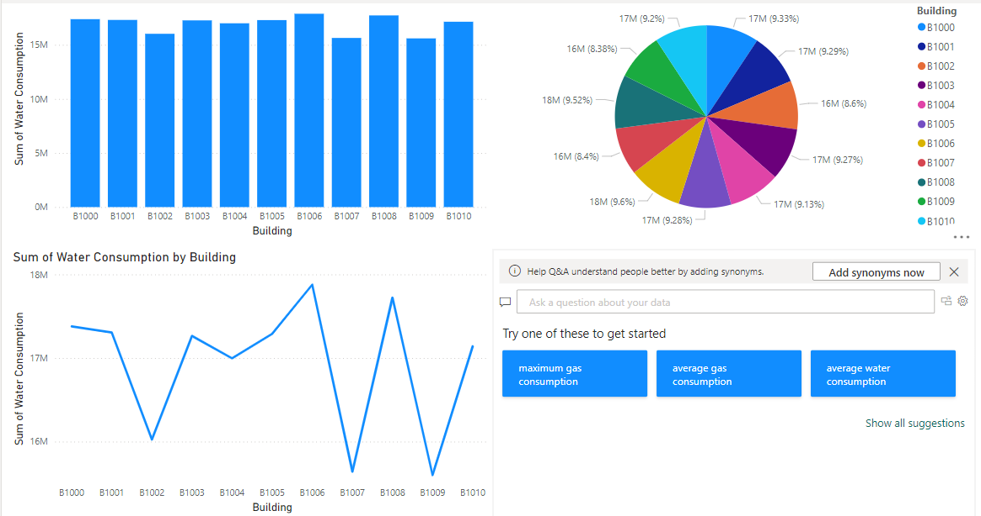

Slide 5
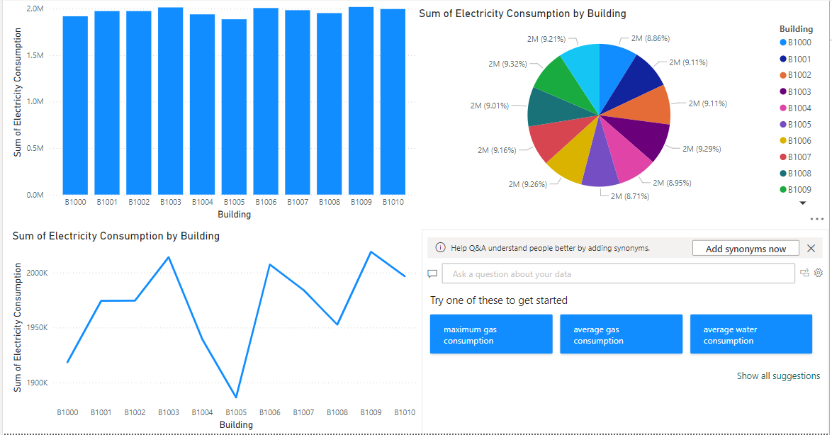

Slide 6
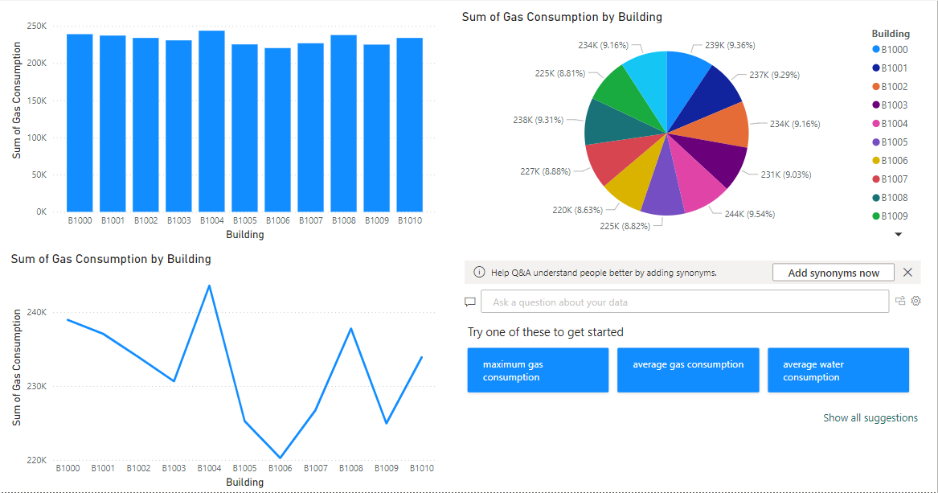

Slide 7
Methodology
Approach:
1. Visual Inspection.
2. Check Indicators and Displays.
3. Monitor Output.
4. Inspect Battery and DC Input.
5. Review System Logs.etc.
Algorithms Used: 1. Tighten connections; replace damaged components.
2. Refer to manufacturer documentation for solutions.
3. Investigate and correct deviations from specifications.
4. Charge or replace the battery; ensure good connections.
5. Address issues indicated in the logs; update firmware.
Source :
www.freepik.com/

Slide 8

Conclusion
Summary:
We have know about the energy consumption from this ppt and also we know about the problems and what to do next so from this we know that from year16 to 19 the consumption of energy.
Future Work: we want to use less energy
Source :
www.freepik.com/

Slide 9
References
Paste your reference link here

Slide 10
Thank You
Notes:
Thank You !!

